Slide 1
Sorger Lab and Data Extraction

Slide 2
Flow Chart (How to Extract Data)
Registered Image
Nuclei Segmentation
Cytoplasm Segmentation
Segment Each Channel
Apply Cyto Mask to each channel
Cluster Data

Slide 3
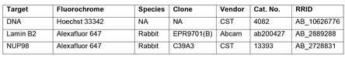
Nuclei Segmentation
Originally thought was “solved” problem
Only “solved” for 2D monolayer cultures
Tissue still unsolved and moderately challenging
unMICST formulated by Sorger lab is current best solution to problem
unMICST utilizes backbone of one of 3 well established networks (uNet, Mask-R-CNN and PSPNet )
Trained on saturated, unfocused and focused data. This augmentation significantly increased accuracy
Also to increase accuracy, stain lamins as well as intercalated dyes ie DAPI. This drastically increased accuracy in high density areas (unMICST has duo model to use with lamin and DAPI dual channel stains)
Unique aspect of unMICST is ability to output nuclei bodies, centroid and borders
Lamins vary nucleus to nucleus via cell types. Following combo is currently known best universal stain:

Slide 4
Cytoplasm Segmentation
More challenging than nucleus
Multiple ways to segment/approximate
Approximation
Pad nucleus segmentation with x pixels (typically 3-5, but depends on um/pixel). Additional layer on this method is to prevent overlapping by using eqi-distance limitations as cytoplasm borders hit each other
This is considered a legit and acceptable approximation. Not just me spitballing
Segmentation Methods
Use Nucleus as a seed and additional channel such as Ecad alongside watershedding
Note given a channel like Ecad typically doesn’t cover the entire cell spectrum, it can be used in hybrid mode with the above approximation to more accurate get epithelial cells and approximate the rest
A power of this is that watershed’s weakness is it inherently doesn’t know seed points. Accurate nuclei segmentation is able to cover up the weakness by supplying it with accurate seed locations
Use stains/combo of stains to segment. Sorger lab has pre built model that uses WGA for segmentation
Note for both methods 1 and 2, stains that outline borders can be added together to target higher amounts of cells
This is essentially the same as number 2, but I wanted to delineate them as the above are available sorger developed. Other models of which CellPose appears to be the best one can use markers like Ecad to find cell boundaries too.

Slide 5
Other channels
These are much easier to execute
No defined segmentation is required (ie separating cells)
Simply must distinguish background from foreground
iLastic models (machine learning) have exceled in this area of application
In certain cases Otsu’s thresholding is acceptable too

Slide 6
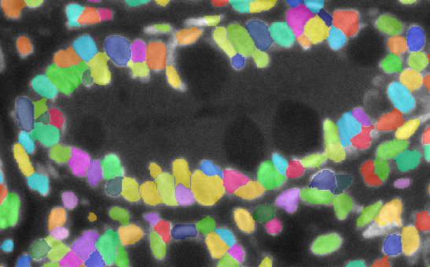
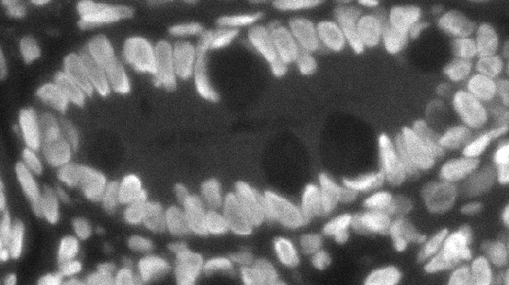
DAPI via unMICST

Slide 7
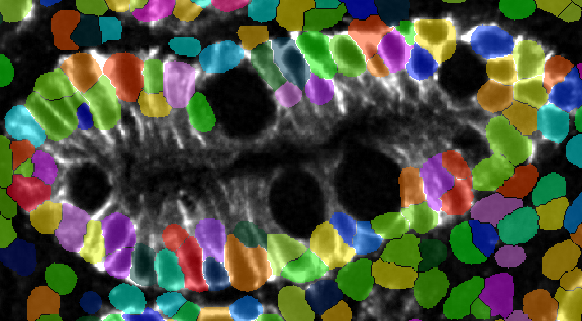
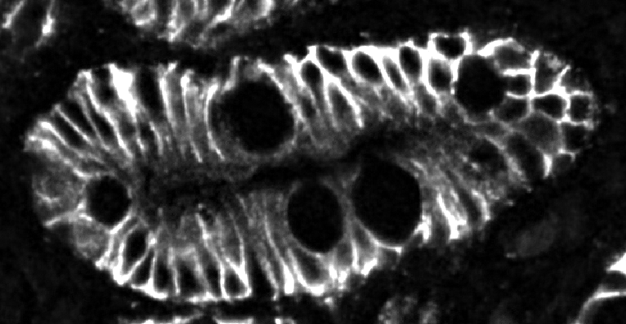
Approximation

Slide 8
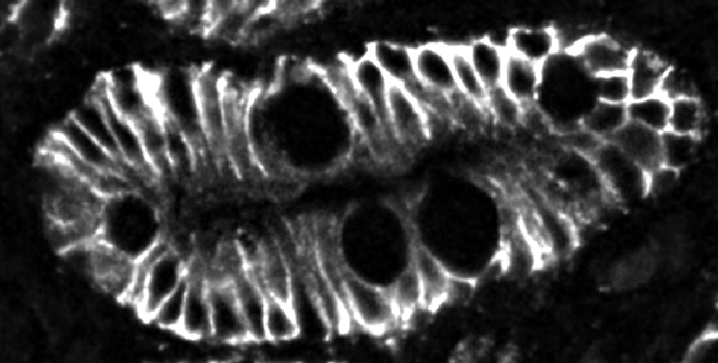
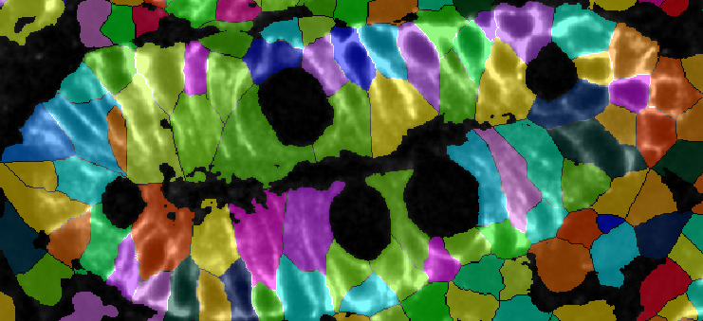
Water Shed assisted seeding

Slide 9
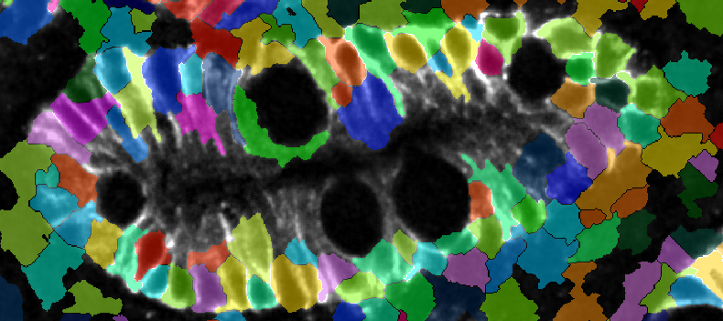
Hybrid

Slide 10
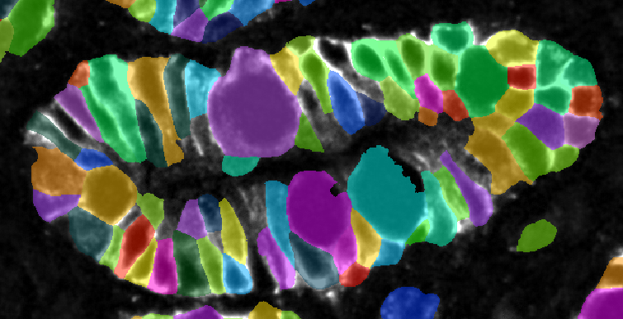

Cell pose partially trained HIL network

Slide 11
Noise2Void demo

Slide 12
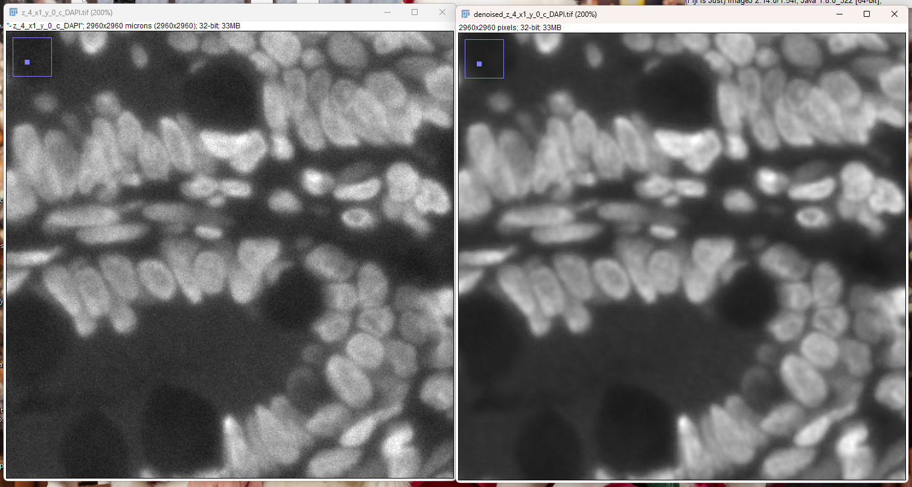
DAPI

Slide 13
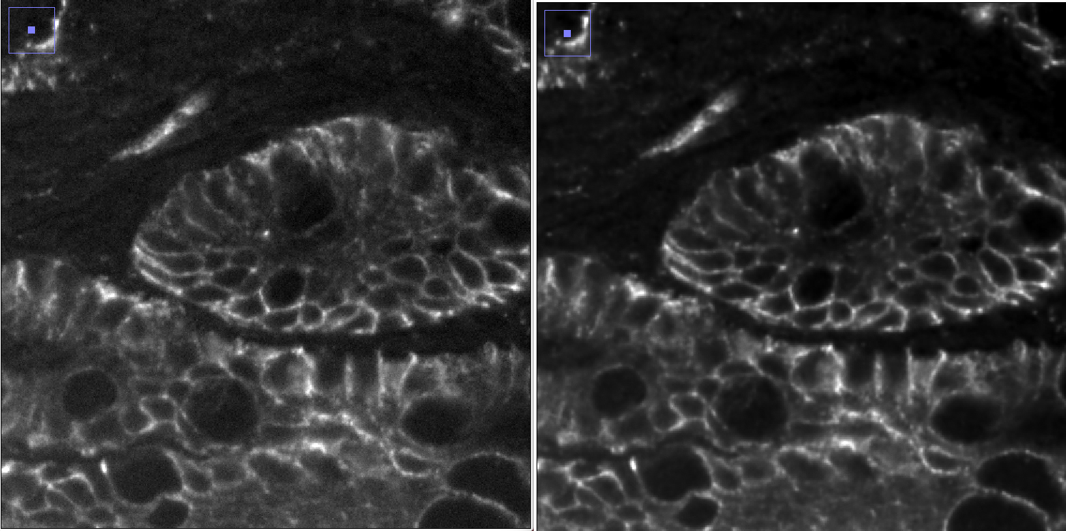
EPCAM

Slide 14
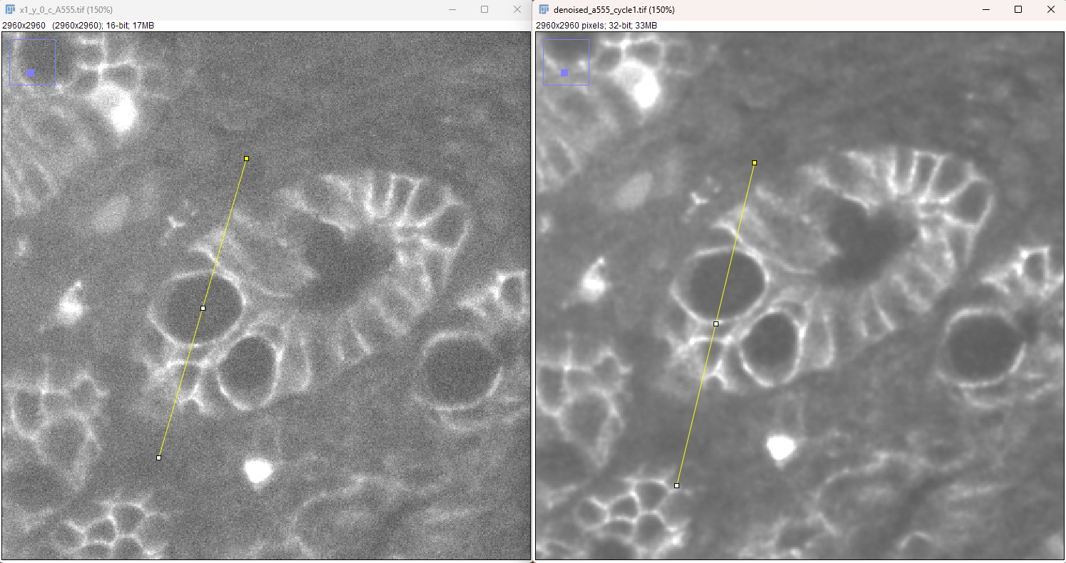
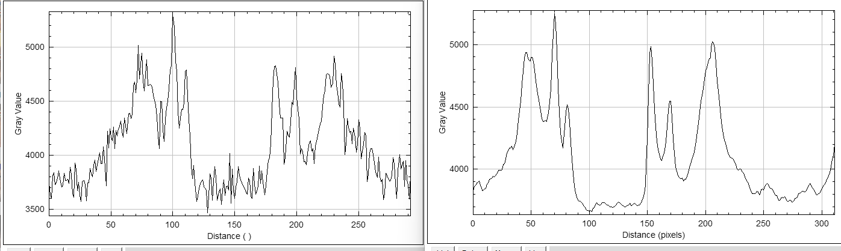
A555_cycle1

Slide 15
Recommended Processing Workflow
Bleached image subtraction
Flatten illumination via BaSiC (current implementation is sloppy, need to actually establish reference images)
Rolling Ball backgnd subtraction
N2V
unMISCH (nuclei), option in StarDist
Use a nuclear based approx. method and or CellPose
iLastic or Otsu models for all other channels
Cluster and visualize via scimap and Minerva (I haven’t investigated this area yet)
Green = processing
Orange = segmentation
Blue = cluster and visualize

Slide 16
Recommended Tasks to Complete
Its very clear that the mcMicro pipeline is very designed and suited to our purposes. Everything recommended here is based on using it.
In no particular order of importance
Implement mcMicro on E2 (this has been started, but needs revisited so it doesn’t die)
Build local workstation for this application?
Understand how to build iLastic models
Understand how to build N2V models outside of ZeroCostDL4MIC environment (Can we quickly build them in E2?)
Train N2V, iLastic, CellPose models
Decide what channels to use for Cellpose model building
Add in Lamin stains into protocol to better segment nuclei
Validate and optimize desired stains
Understand exactly how every part of mcmicro works and everything about available modules in it

